Slide 1


21DS636- Statistical Modelling
Exploratory Data Analysis
Dr. Deepa Gupta, Professor
Human Language Technology Lab
Dept. of computer Science and Engineering
Amrita School of Engineering, Bangalore

Slide 2
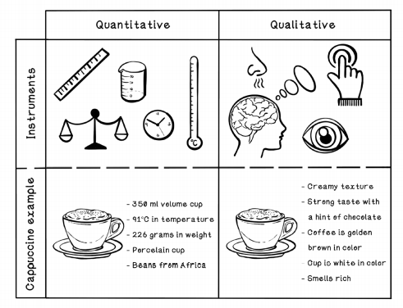
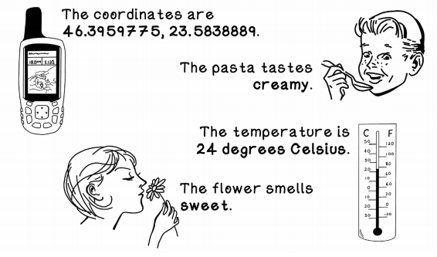
Data is Core to AI/ML/DM/DS Algorithms
When we look at living organisms and machines, we see that the core element for operation is data.
Visuals that we see are data;
sounds that we hear are data;
measurements of the things around us are data.
We consume data, process it all, and make decisions based on it;
So, a fundamental understanding of the concept's surrounding data is important for understanding AI/ML/DM/DS Algorithms

Slide 3
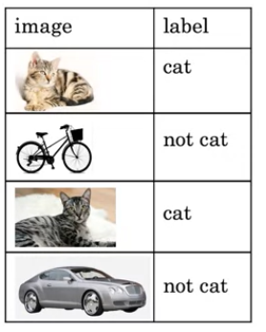
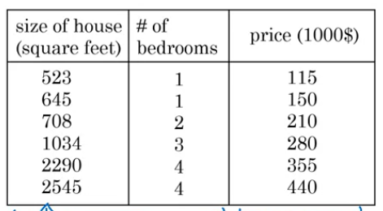
What is Data?
Data is different types of information usually formatted in a particular manner.

Slide 4
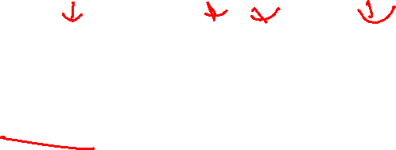
Data As you Know It
How do you think about data? --Think of a spreadsheet
Column: All the data in one column will have the same scale and have meaning relative to each other.
Row: A row describes a single entity or observation and the columns describe properties about that entity or observation. The more rows you have, the more examples from the problem domain that you have.
Cell: A cell is a single value in a row and column. It may be a real value (1.5), an integer (2) or a category (red).
NOTE: we can call this type of data: tabular data. This form of data is easy to work with in AI/ML/DS.

Slide 5
Statistical Learning Preceptive
The statistical perspective frames data in the context of a hypothetical function (f) that the machine learning algorithm is trying to learn. That is, given some input variables (input), what is the predicted output variable (output).
Output = f(Input)
Those columns that are the inputs are referred to as input variables. you would like to predict for new input data in the future is called the output variable. It is also called the response variable.
Output Variable = f(Input Variables)
Output Variable = f(Input Vector)
Dependent Variable = f(Independent Variables)
The standard shorthand used in the statistical perspective is to refer to the input variables as capital X and the output variables as capital Y . →Y = f(X)

Slide 6
Computer Science perspective
There is a lot of overlap in the computer science terminology for data with the statistical perspective.
Output Attribute = Program(Input Attributes)
Output = Program(Input Features)

Slide 7
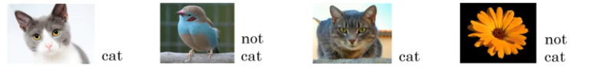
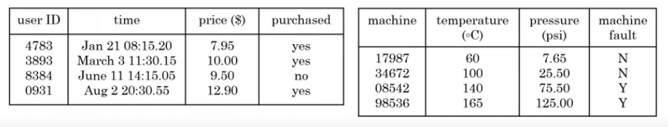
Acquiring Data
Manual labeling
From observing behaviors
Download from websites/partnerships

Slide 8
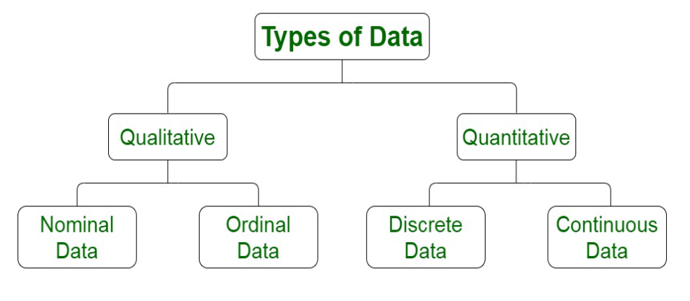

Slide 9
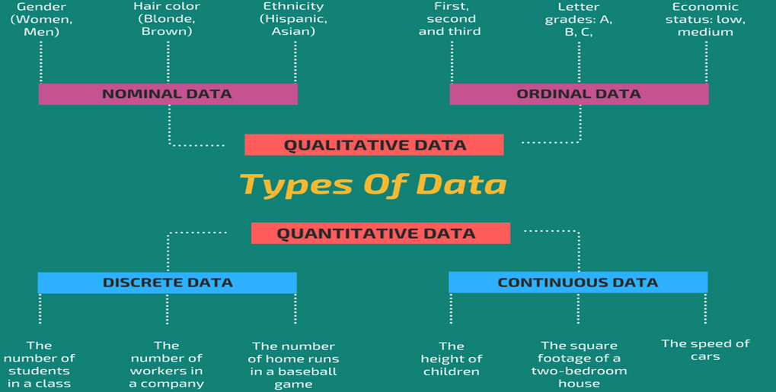

Slide 10
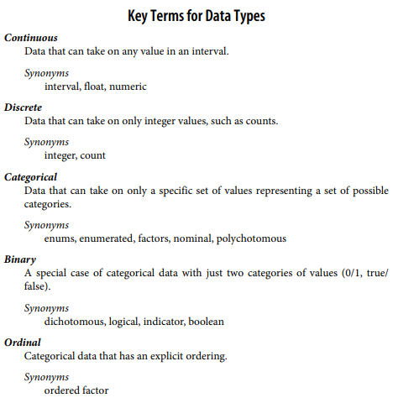
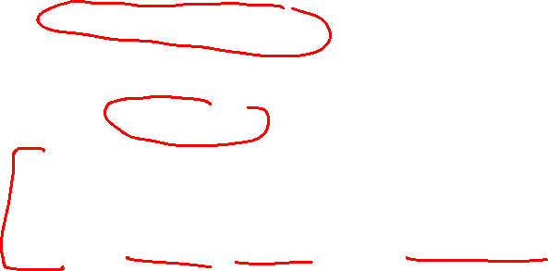

Slide 11
Why do we bother with a taxonomy of data types?
It turns out that for the purposes of data analysis and predictive modeling, the data type is important to help determine the type of visual display, data analysis, or statistical model.
In fact, data science software, such as R and Python, uses these data types to improve computational performance.
More important, the data type for a variable determines how software will handle computations for that variable.
Knowing that data is categorical can act as a signal telling software how statistical procedures, such as producing a chart or fitting a model, should behave.
Storage and indexing can be optimized (as in a relational database).
The possible values a given categorical variable can take are enforced in the software (like an enum).

Slide 12
Key Take Away
Data is typically classified in software by type.
Data types include continuous, discrete, categorical (which includes binary), and ordinal.
Data typing in software acts as a signal to the software on how to process the data

Slide 13
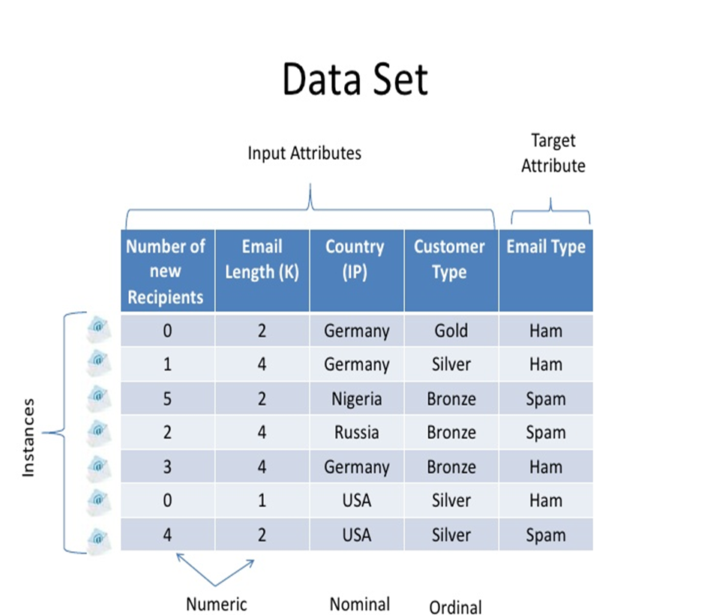
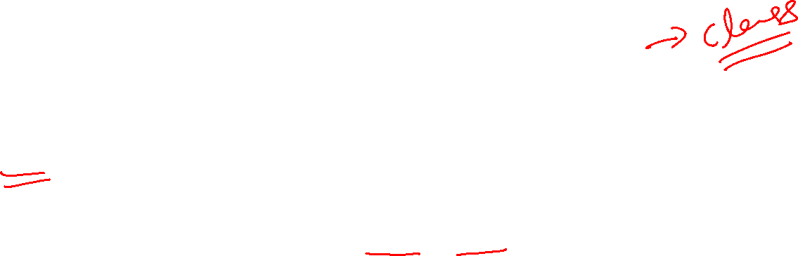
How the actual data look Like…

Slide 14
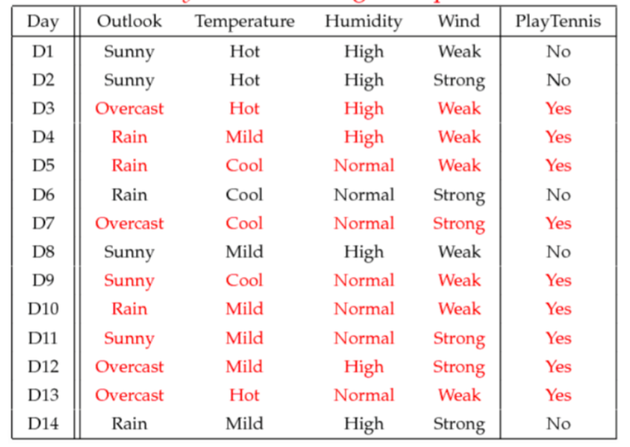
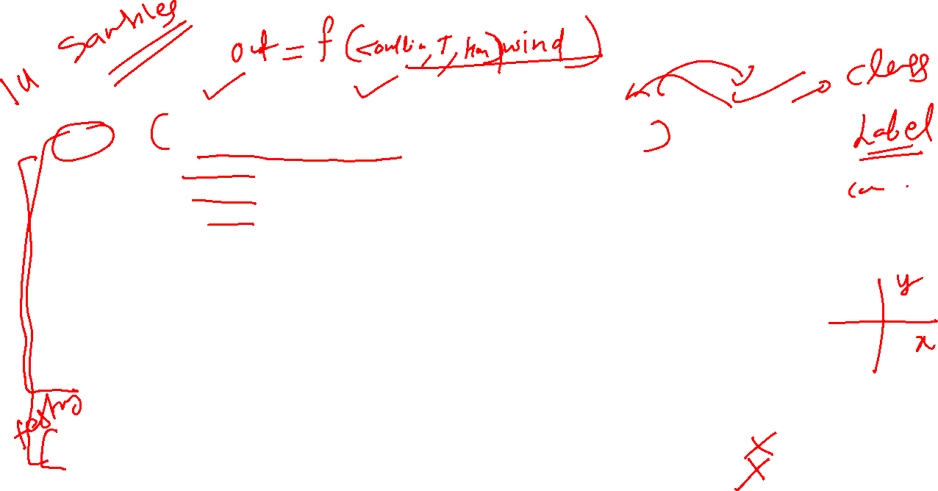
More Examples

Slide 15
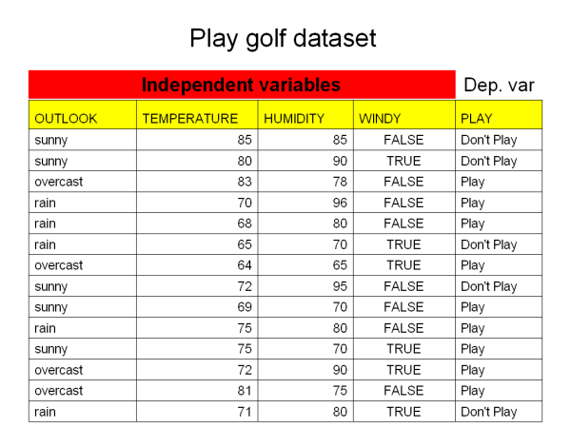
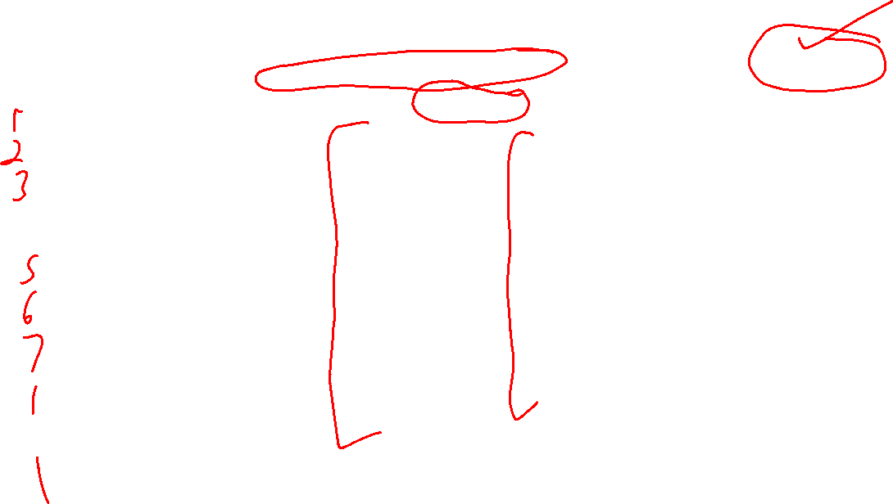
More Examples

Slide 16
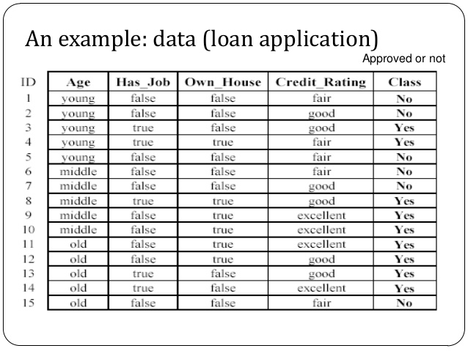
More Examples

Slide 17
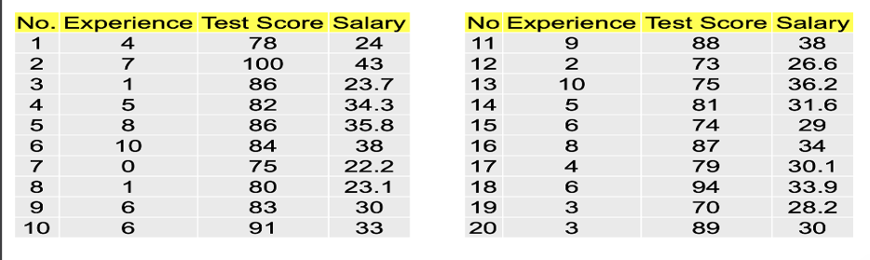
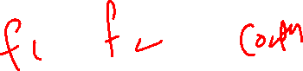
More Examples

Slide 18
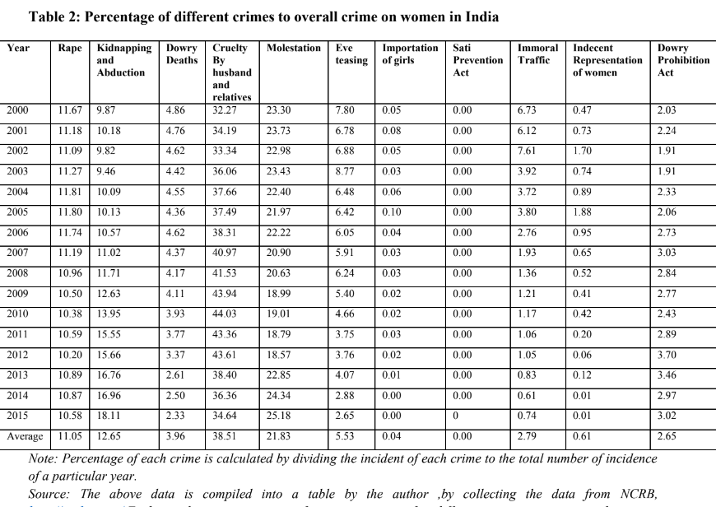

Slide 19
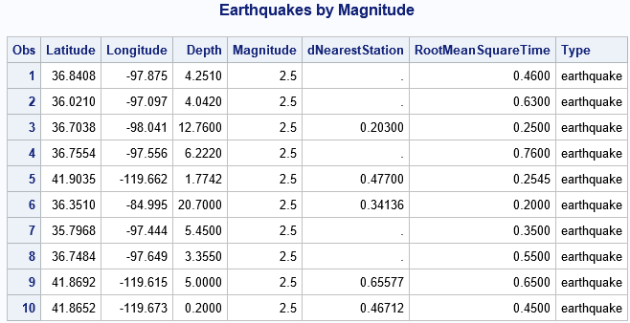
More Examples

Slide 20
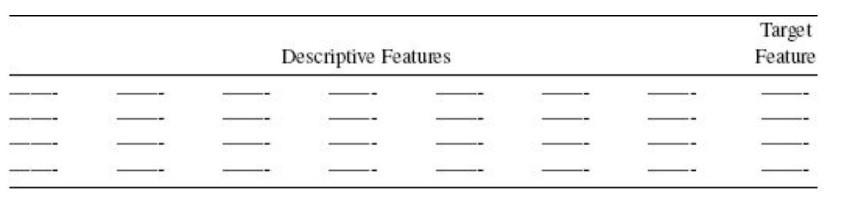
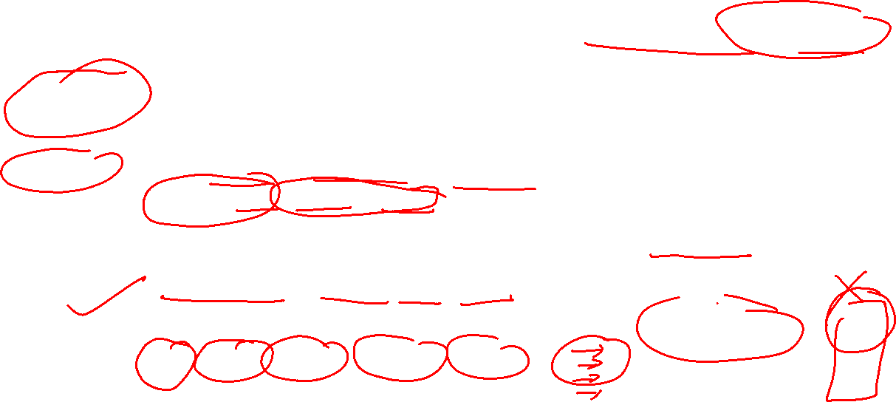
Rectangular Data/ Analytics Base Table (ABT)
The typical frame of reference for an analysis in data science is a rectangular data object, like a spreadsheet or database table.
Data frame: Rectangular data (like a spreadsheet) is the basic data structure for statistical and machine learning models.
Feature: column in the table is commonly referred to as a feature.
Synonyms: attribute, input, predictor, variable
Outcome: Many data science projects involve predicting an outcome—often a yes/no out‐ come. The features are some‐ times used to predict the outcome in an experiment or study.
Synonyms: dependent variable, response, target, output
Records: A row in the table is commonly referred to as a record.
Synonyms: case, example, instance, observation, pattern, sample

Slide 21
Data Exploration
Before attempting to build predictive models based on an ABT/Rectangular Data, it is important that we undertake some exploratory analysis, or data exploration, of the data contained in the ABT/ Rectangular Data
Data exploration is a key part of both the Data Understanding and, Data Preparation.

Slide 22
Data Exploration-Goals
Fully understand the characteristics of the data in the ABT
types of values a feature can take
the ranges into which the values in a feature fall
how the values in a dataset for a feature are distributed across the range.
Data quality issues
missing values
instance has an extremely high value for a feature
invalid data
perfectly valid data that may cause difficulty to some machine learning techniques.
The most important tool used during data exploration is the data quality report.

Slide 23
Data Quality Report
The data quality report is the most important tool of the data exploration process.
A data quality report includes tabular reports (one for continuous features and one for categorical features) that describe the characteristics of each feature in an ABT using standard statistical measures of central tendency (mean, mode, and median) and variation (standard deviation and percentiles).
The tabular reports are accompanied by data visualizations (bar plots, histograms, and box plots) that illustrate the distribution of the values in each feature in an ABT.

Slide 24
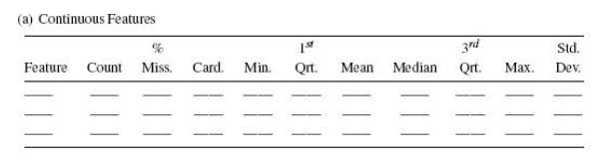
Data Quality Report - Continuous Features
The table in a data quality report that describes continuous features should include:
minimum,
1st quartile,
mean,
median,
3rd quartile,
maximum,
standard deviation
the percentage of instances in the ABT that are missing a value for each feature
the cardinality of each feature, (cardinality measures the number of distinct values present in the ABT for a feature).

Slide 25
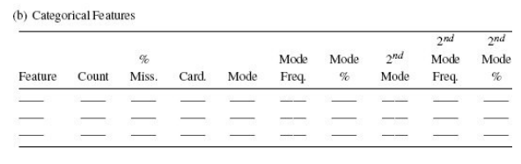
Data Quality Report - Categorical Features
The table in the data quality report that describes categorical features should include:
A row for each feature in the ABT that contains the two most frequent levels for the feature (the mode and 2nd mode)
The frequency with which these appear (both as raw frequencies and as a proportion of the total number of instances in the dataset).
missing a value for the feature
The cardinality of the feature.

Slide 26
Data Quality Report - continuous features & categorical features
The data quality report should also include a histogram for each continuous feature in an ABT.
For continuous features with cardinality less than 10, we use bar plots instead of histograms as this usually produces more informative data visualization.
For each categorical feature in an ABT, a bar plot should be included in the data quality report

Slide 27
Descriptive Statistics

Slide 28
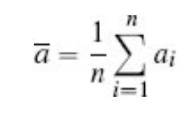
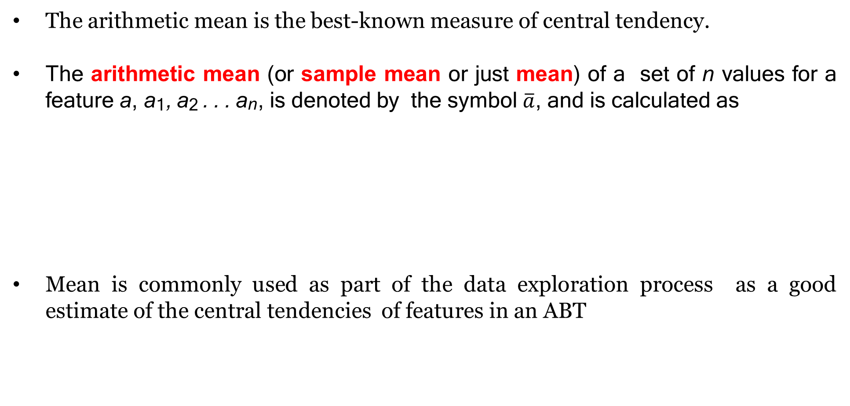
Central Tendency
The arithmetic mean is the best-known measure of central tendency.
The arithmetic mean (or sample mean or just mean) of a set of n values for a feature a, a₁, a₂ . . . a_{n}, is denoted by the symbol $\overline{a}$, and is calculated as
Mean is commonly used as part of the data exploration process as a good estimate of the central tendencies of features in an ABT

Slide 29
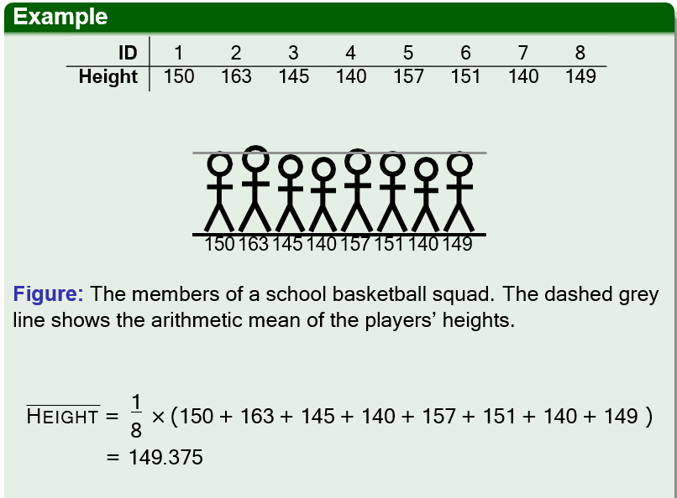
The arithmetic mean is one measure of the central tendency of a sample (for our purposes a sample is just a set of values for a feature in an ABT).
Any measure of central tendency is, however, just an approximation.

Slide 30
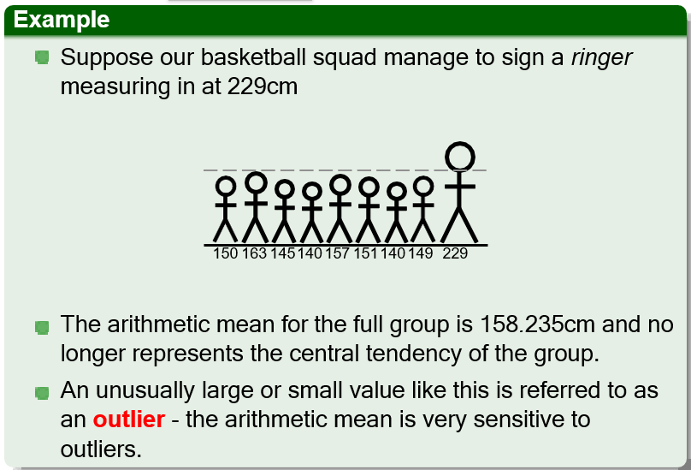

Slide 31
Contd..
There are other statistics that we can use to measure central tendency that are not as sensitive to outliers.
The median of a set of values can be calculated by ordering the values from lowest to highest and selecting the middle value.
If there is an even number of values in the sample, then the median is obtained by calculating the arithmetic mean of the middle two values.

Slide 32
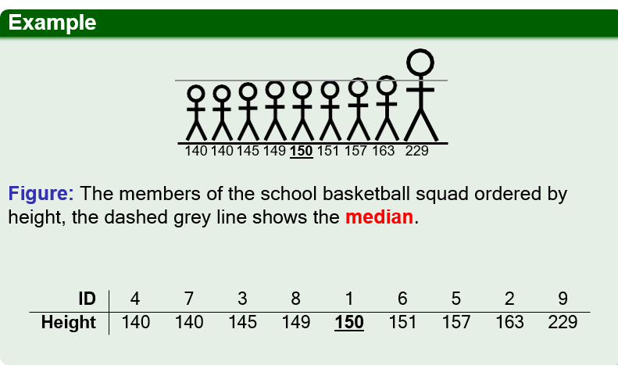

Slide 33
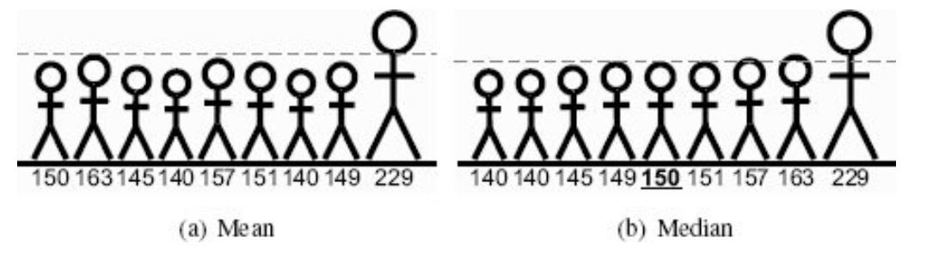
Median is not as sensitive to outliers as mean is.
A large difference between the mean and median of a feature is an indication that there may be outliers among the feature values

Slide 34
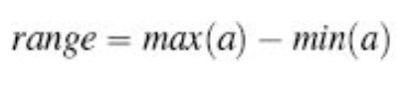
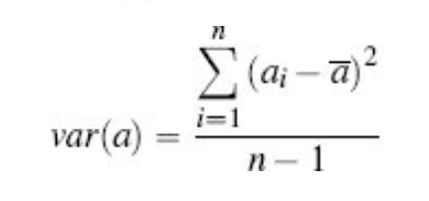
We also measure the variation in our data
In essence, most of statistics, and in turn analytics, is about describing and understanding variation.
Range –most easily calculated measure of variation
Variance - measures the average difference between each value in a sample and the mean of that sample

Slide 35
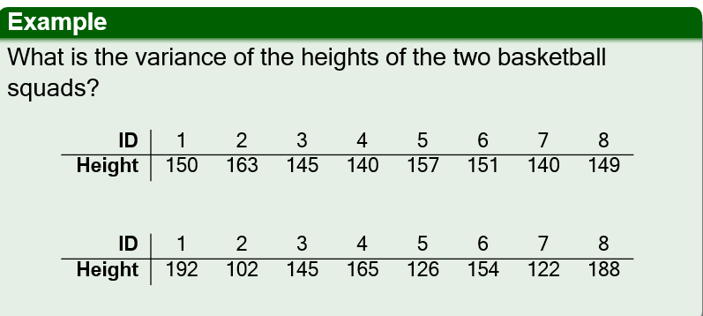
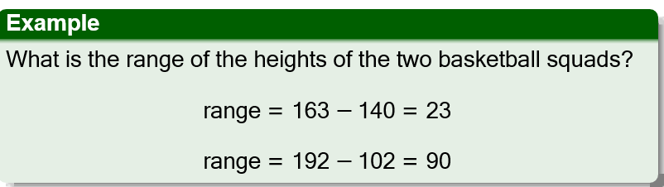

Slide 36
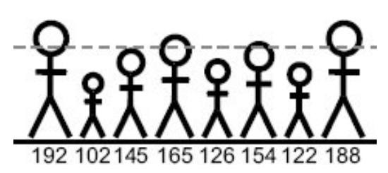
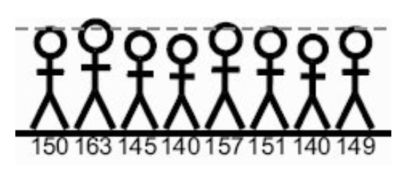
Variance
Fig. 1
Fig. 2
The data represented by both Fig 1 and Fig 2 has same Mean (149.39).
But Fig 2 has more variation in the data.

Slide 37
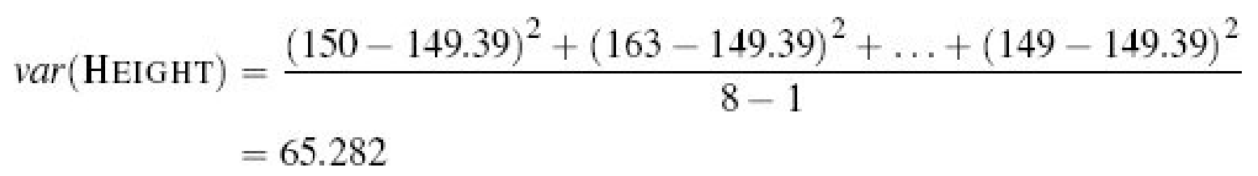
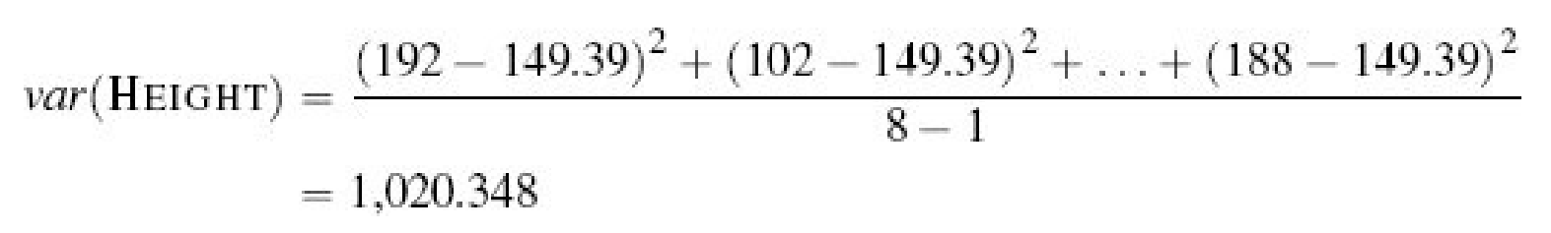

Slide 38
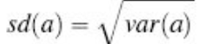
Standard Deviation:
The standard deviation of the heights of the players on the first basketball team is 8.080 and for the second team is 31.943.
These measures are in the same units as the heights.
We can say that, on average, players on the first team vary by 8cm from the average of 149.39cm, while on the second team, they vary by approximately 32cm

Slide 39
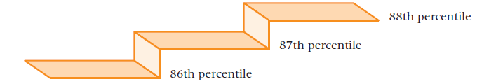
Percentiles –another measure of variation
Percentiles are measures of central tendency that divide a group of data into 100 parts.
There are 99 percentiles because it takes 99 dividers to separate a group of data into 100 parts.
The nth percentile is the value such that at least n percent of the data are below that value and at most (100 - n) percent are above that value.
Specifically, the 87th percentile is a value such that at least 87% of the data are below the value and no more than 13% are above the value.
Percentiles are “stair-step” values, as shown in Figure , because the 87th percentile and the 88th percentile have no percentile between.

Slide 40
Percentiles are widely used in reporting test results.
Almost all college or university students have taken the SAT, GRE, or GMAT examination.
In most cases, the results for these examinations are reported in percentile form and also as raw scores.

Slide 41
Interquartile range (IQR): another measure of variation
The inter-quartile range is calculated as the difference between the 25th percentile (Q1) and the 75th percentile(Q2). About 50% of the data is between Q1 and Q3.
These percentiles are also known as the lower quartile (or 1st quartile) and the upper quartile (or 3rd quartile)
The inter-quartile range is 151 −140 = 11, while for the second team, it is 165 − 122 = 43.

Slide 42
Key Ideas
The basic metric for location is the mean, but it can be sensitive to extreme values (outlier).
Other metrics (median, trimmed mean) are more robust.
The variance and standard deviation are the most widespread and routinely reported statistics of variability.
Both are sensitive to outliers.
More robust metrics include mean, median, absolute deviations from the mean and percentiles.

Slide 43
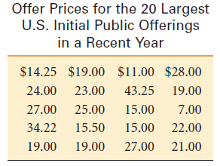
The mode is a measure of the central tendency of a categorical feature and is simply the most frequent level.
We often also calculate a second mode which is just the second most common level of a feature.
For the data in Table the mode is $19.00 because the offer price that recurred the most times (four) was $19.00.
Organizing the data into an ordered array (an ordering of the numbers from smallest to largest) helps to locate the mode.
7.00 11.00 14.25 15.00 15.00 15.50 19.00 19.00 19.00 19.00 21.00 22.00 23.00
24.00 25.00 27.00 27.00 28.00 34.22 43.25

Slide 44
Mode
In the case of a tie for the most frequently occurring value, two modes are listed.
Then the data are said to be bimodal.
If a set of data is not exactly bimodal but contains two values that are more dominant than others, some researchers take the liberty of referring to the data set as bimodal even without an exact tie for the mode.
Data sets with more than two modes are referred to as multimodal.

Slide 45
Example
4,6,4,1,8,7,7,2,5,7
1,2,4,4,5,6,7,7,7,8 - mode – 7
4,3,7,1,8,9,6
1,3,4,6,7,8,9 – no value repeating – NO MODE
2,7,5,2,8,9,7,3
2,2,3,5,7,7,8,9 – 2 n 7 repeated equally – Modes – 2 n 7 – Bi modal

Slide 46
For categorical features we are interested primarily in frequency counts and proportions.
The frequency count of each level of a categorical feature is calculated by counting the number of times that level appears in the sample.
The proportion for each level is calculated by dividing the frequency count for that level by the total sample size.
Frequencies and proportions are typically presented in a frequency table.

Slide 47
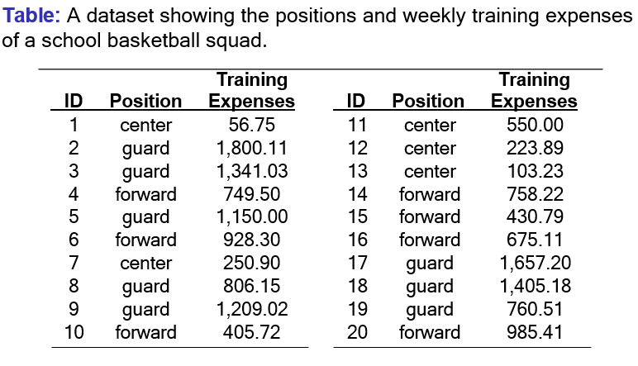

Slide 48
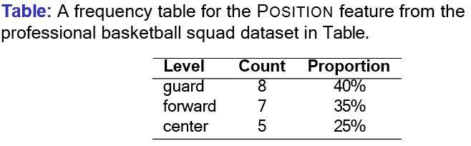

Slide 49
Data Visualization

Slide 50
When performing data exploration data visualization can help enormously.
We will describe three important data visualization techniques that can be used to visualize the values in a single feature:
the bar plot
the histogram
the box plot

Slide 51
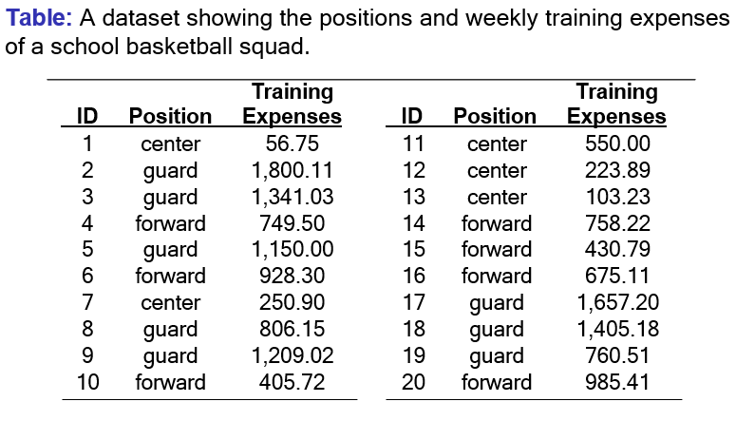

Slide 52
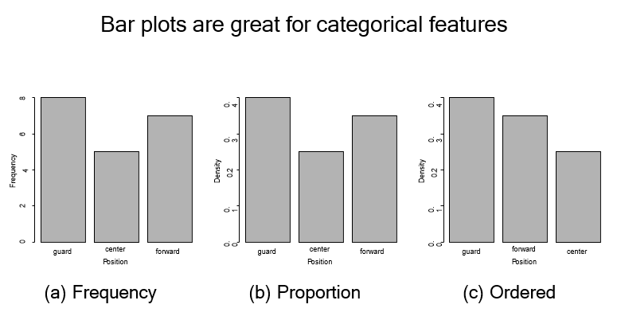
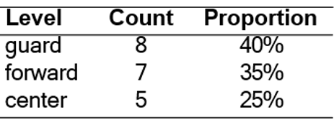
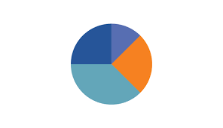
Bar charts: The frequency or proportion for each category plotted as bars.
Pie charts: The frequency or proportion for each category plotted as wedges in a pie.

Slide 53
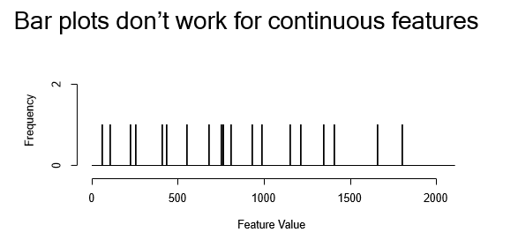

Slide 54

2/(20x200)
By dividing the range of a variable into intervals, or bins, we can generate histograms

Slide 55

Frequency and density histograms for the continuous Training Expenses feature from Table
A frequency histogram plots frequency counts on the y-axis and variable values on the x-axis; it gives a sense of the distribution of the data at a glance
A density plot is a smoothed version of a histogram; it requires a function to estimate a plot based on the data (multiple estimates are possible, of course)

Slide 56

Box plots/ whisker plots are another useful way of visualising continuous variables
A box and whisker plot—also called a box plot—displays the five-number summary of a set of data.
The five-number summary is the minimum, first quartile, median, third quartile, and maximum.

Slide 57
Key points-Box plot
A boxplot—with the top and bottom of the box at the 75th and 25th percentiles, respectively—also gives a quick sense of the distribution of the data; it is often used in side-by-side displays to compare distributions
The whiskers that emerge from the top and bottom of the main rectangle in a box plot are designed to show the range of the data
Values that fall outside the whiskers are referred to as outliers and are shown as small circles

Slide 58

Figure: A box plot for the TRAINING EXPENSES feature from the basketball squad dataset in Table

Slide 59

Question: The following box plots show how many hours of TV is watched by a year 11 class (orange) and a year 9 class (grey) in a given month. Compare the box plots
When comparing box plots you want to look at the median and interquartile range as your first two comparisons.
The median time is greater for the year 9 class.
The year 9 class also have a larger interquartile range.

Slide 60

Question: The box plots show the distribution of the number of team wristbands sold daily by two different stores over the same time period.
Compare the shapes of the box plots.
Answer: Store A’s box and right whisker are longer than Store B’s.

Slide 61
Question: The box plots show the distribution of the number of team wristbands sold daily by two different stores over the same time period.
Compare the centers of the box plots.
Answer: Store A’s median is about 43, and Store B’s is about 51. Store A’s median is close to Store B’s minimum value, so about 50% of Store A’s daily sales were less than sales on Store B’s worst day.

Slide 62

Question: The box plots show the distribution of the number of team wristbands sold daily by two different stores over the same time period.
Compare the spreads of the box plots.-
Answer: Store A has a greater spread. Its range and inter quartile range are both greater. Four of Store B’s key values are greater than Store A’s corresponding value. Store B had a greater number of sales overall.

Slide 63
Identifying Data Quality Issues

Slide 64
A data quality issue is loosely defined as anything unusual about the data in an ABT/Rectangular Data frame.
The most common data quality issues are:
missing values
irregular cardinality
outliers
The data quality issues we identify from a data quality report will be of two types:
Data quality issues due to invalid data.
Data quality issues due to valid data.

Slide 65
Data Quality issues
Valid data –need not take any coercive action unless required by ML models
Invalid data- immediate actions to correct them

Slide 66

Missing Data
Data is not always available
e.g., many tuples have no recorded value for several attributes
Missing data may be due to
equipment malfunction
inconsistent with other recorded data and thus deleted
data not entered due to misunderstanding
certain data may not be considered important at the time of entry
not register history or changes of the data

Slide 67
Missing Values
Highlight the percentage of missing values for each feature
If proportion of missing values in a feature is >60%, good idea to remove

Slide 68

Missing Values Handling
Imputation replaces missing feature values with a plausible estimated value based on the feature values that are present.
The most common approach to imputation is to replace missing values for a feature with a measure of the central tendency of that feature.
We would be reluctant to use imputation on features missing in excess of 30% of their values and would strongly recommend against the use of imputation on features missing in excess of 50% of their values.

Slide 69

Irregular cardinality
Cardinality-number of distinct values present for a feature
Issue- when the cardinality for a feature does not match what we expect
features with a cardinality of 1.
same value for every instance and contains no information useful for building predictive models
Categorical features incorrectly labeled as continuous.
the number of children a person has 1 for female and 0 for male
Categorical feature has a much higher cardinality
categorical feature storing gender with a cardinality of 6
categorical feature simply has a very high number of levels- above 50

Slide 70


Handle Outliers
The easiest way to handle outliers is to use a clamp transformation that clamps all values above an upper threshold and below a lower threshold to these threshold values, thus removing the offending outliers
where a_{i} is a specific value of feature a, and lower and upper are the lower and upper threshold

Slide 71

Handle Outliers
The upper and lower thresholds can be set manually based on domain knowledge or can be calculated from data.
calculate clamp thresholds-
lower threshold to the 1st quartile value minus 1.5 times the inter-quartile range i.e. Q1-1.5xIQR
upper threshold to the 3rd quartile plus 1.5 times the inter-quartile range. i.e. Q3+1.5IQR
setting the upper and lower thresholds to the mean value of a feature plus or minus 2 times the standard deviation
Strong Outlier
Outliers with extreme deviation from the rest of the dataset.
Weak Outlier

Slide 72

Determining Outliers:. Data point < Q1-1.5xIQR
Data point> Q3+1.5xIQR
Strong Outliers : Data point < Q1-3.0xIQR
Data point> Q3+3.0xIQR
Data point is considered as Strong outliers
Weak Outliers : Besides strong outliers, there is another category for outliers. If a data value is an outlier, but not a strong outlier, then we say that the value is a weak outlier.
Data point is considered as outliers

Slide 73

Example 1
First, suppose that we have the data set {1, 2, 2, 3, 3, 4, 5, 5, 9}. The number 9 certainly looks like it could be an outlier. It is much greater than any other value from the rest of the set.
To objectively determine if 9 is an outlier, we use the above methods. The first quartile is 2 and the third quartile is 5, which means that the interquartile range is 3.
We multiply the interquartile range by 1.5, obtaining 4.5, and then add this number to the third quartile. The result, 9.5, is greater than any of our data values. Therefore, there are no outliers.

Slide 74

Example 2
Now we look at the same data set as before, with the exception that the largest value is 10 rather than 9: {1, 2, 2, 3, 3, 4, 5, 5, 10}.
The first quartile, third quartile, and interquartile range are identical to example 1.
When we add 1.5 x IQR = 4.5 to the third quartile, the sum is 9.5. Since 10 is greater than 9.5 it is considered an outlier.
Is 10 a strong or weak outlier? For this, we need to look at 3 x IQR = 9.
When we add 9 to the third quartile, we end up with a sum of 14. Since 10 is not greater than 14, it is not a strong outlier. Thus, we conclude that 10 is a weak outlier.

Slide 75


When we generate histograms of features there are a number of common, well understood shapes that we should look out for.
Histograms for different sets of data each of which exhibit well-known, common characteristics.

Slide 76

A uniform distribution indicates that a feature is equally likely to take a value in any of the ranges present.
Uniform

Slide 77


Features following a normal distribution are characterized by a strong tendency towards a central value and symmetrical variation to either side of this.

Slide 78

A fundamental task in many statistical analyses is to characterize the location and variability of a data set.
A further characterization of the data includes skewness and kurtosis.

Slide 79



Data is skewed when its distribution curve is asymmetrical (as compared to a normal distribution curve that is perfectly symmetrical) and skewness is the measure of the asymmetry.
The skewness for a normal distribution is 0.

Slide 80




Slide 81


How to measure skewness??
There are 2 different types of skews in data, left(negative) or right(positive) skew.
Effects of skewed data: Degrades the model’s ability (especially regression based models) to describe typical cases as it has to deal with rare cases on extreme values. ie right skewed data will predict better on data points with lower value as compared to those with higher values.
Skewed data also does not work well with many statistical methods. However, tree based models are not affected
To ensure that the machine learning model capabilities is not affected, skewed data has to be transformed to approximate to a normal distribution.

Slide 82






Pearson’s Coefficient of Skewness
Karl Pearson developed two methods to measure skewness in a sample.
Pearson’s Coefficient of Skewness #1 uses the mode.
The formula is:
Pearson’s Coefficient of Skewness #2 uses the median.
The formula is:
where $\overline{X}$ = the mean, Mo = the mode and s = the standard deviation for the sample.
Where $\overline{X}$ = the mean, Md = the mode and s = the standard deviation for the sample.

Slide 83

Example problem: Use Pearson’s Coefficient #1 and #2 to find the skewness for data with the following characteristics:
Mean = 70.5.
Median = 80.
Mode = 85.
Standard deviation = 19.33.
Pearson’s Coefficient of Skewness #1 (Mode): Step 1: Subtract the mode from the mean: 70.5 – 85 = -14.5. Step 2: Divide by the standard deviation: -14.5 / 19.33 = -0.75.
Pearson’s Coefficient of Skewness #2 (Median): Step 1: Subtract the median from the mean: 70.5 – 80 = -9.5. Step 2: Multiply Step 1 by 3: -9.5(3) = -28.5 Step 2: Divide by the standard deviation: -28.5 / 19.33 = -1.47.

Slide 84

Interpretation
In general:
The direction of skewness is given by the sign.
The coefficient compares the sample distribution with a normal distribution.
The larger the value, the larger the distribution differs from a normal distribution.
A value of zero means no skewness at all.
A large negative value means the distribution is negatively skewed.
A large positive value means the distribution is positively skewed.

Slide 85

Caution
Pearson’s first coefficient of skewness uses the mode. Therefore, if the mode is made up of too few pieces of data it won’t be a stable measure of central tendency.
For example, the mode in both these sets of data is 9: 1 2 3 4 5 6 7 8 9 9. 1 2 3 4 5 6 7 8 9 9 9 9 9 9 9 9 9 9 9 9 10 12 12 13.
In the first set of data, the mode only appears twice. This isn’t a good measure of central tendency so you would be cautioned not to use Pearson’s coefficient of skewness.
The second set of data has a more stable set (the mode appears 12 times). Therefore, Pearson’s coefficient of skewness will likely give you a reasonable result.

Slide 86

Kurtosis
Kurtosis is a measure of whether the data are heavy-tailed or light-tailed relative to a normal distribution. That is, data sets with high kurtosis tend to have heavy tails, or outliers. Data sets with low kurtosis tend to have light tails, or lack of outliers.
Kurtosis is a measure of the tailedness of a distribution. Tailedness is how often outliers occur. Excess kurtosis is the tailedness of a distribution relative to a normal distribution.
Distributions with medium kurtosis (medium tails) are mesokurtic.
Distributions with low kurtosis (thin tails) are platykurtic.
Distributions with high kurtosis (fat tails) are leptokurtic.
The histogram is an effective graphical technique for showing both the skewness and kurtosis of data set.

Slide 87



A normal distribution has a kurtosis of 3 and is called mesokurtic.
excess kurtosis= kurtosis − 3.
The greater the value more the peakedness.

Slide 88

Kurtosis

Slide 89



Kurtosis
The Kurtosis of a given set of ungrouped data values can be calculated using the formula,
Ungrouped Data Kurtosis Calculation
Grouped Data Kurtosis Calculation
Frequency count=f_{i}

Slide 90


Slide 91



Excess Kurtosis= kurtosis-3=2.1745-3=-0.8255
Platykurtic
Tailedness is Thin-tailed and outlier frequency is low

Slide 92



Slide 93




Slide 94



Excess Kurtosis= kurtosis-3=2.7149-3=-0.2851
Platykurtic
Tailedness is Thin-tailed and outlier frequency is low

Slide 95
Note
Although a population’s probability distribution can have a kurtosis of exactly 3, real data is almost always at least slightly platykurtic or leptokurtic.
If a sample has a kurtosis of approximately 3, you can assume it’s drawn from a mesokurtic population (i.e. normal population.

Slide 96


In a feature following an exponential distribution the likelihood of occurrence of a small number of low values is very high, but sharply diminishes as values increase.
Values for an exponential random variable occur in the following way.
There are fewer large values and more small values.
For example, the amount of money customers spend in one trip to the supermarket follows an exponential distribution. There are more people who spend small amounts of money and fewer people who spend large amounts of money.
The value of the change that you have in your pocket or purse approximately follows an exponential distribution

Slide 97


A feature characterized by a multimodal distribution has two or more very commonly occurring ranges of values that are clearly separated.
Figure shows a bi-modal distribution with two clear peaks—we can think of this as two normal distributions pushed together.
Multimodal distributions tend to occur when a feature contains a measurement made across a number of distinct groups.
For example, if we were to measure the heights of a randomly selected group of Irish men and women, we would expect a bi-modal distribution with a peak at around 1.635m for women and 1.775m for men.

Slide 98
Advanced Data Exploration

Slide 99

The details of a professional basketball teams
ID | Position | Height | Weight | Career Stage | Age | Sponsorship Earnings | Shoe Sponsor
1 | forward | 192 | 218 | veteran | 29 | 561 | yes
2 | center | 218 | 251 | mid-career | 35 | 60 | no
3 | forward | 197 | 221 | rookie | 22 | 1,312 | no
4 | forward | 192 | 219 | rookie | 22 | 1,359 | no
5 | forward | 198 | 223 | veteran | 29 | 362 | yes
6 | guard | 166 | 188 | rookie | 21 | 1,536 | yes
7 | forward | 195 | 221 | veteran | 25 | 694 | no
8 | guard | 182 | 199 | rookie | 21 | 1,678 | yes
9 | guard | 189 | 199 | mid-career | 27 | 385 | yes
10 | forward | 205 | 232 | rookie | 24 | 1,416 | no
11 | center | 206 | 246 | mid-career | 29 | 314 | no
12 | guard | 185 | 207 | rookie | 23 | 1,497 | yes
13 | guard | 172 | 183 | rookie | 24 | 1,383 | yes
14 | guard | 169 | 183 | rookie | 24 | 1,034 | yes
15 | guard | 185 | 197 | mid-career | 29 | 178 | yes
16 | forward | 215 | 232 | mid-career | 30 | 434 | no
17 | guard | 158 | 184 | veteran | 29 | 162 | yes
18 | guard | 190 | 207 | mid-career | 27 | 648 | yes
19 | center | 195 | 235 | mid-career | 28 | 481 | no
20 | guard | 192 | 200 | mid-career | 32 | 427 | yes
21 | forward | 202 | 220 | mid-career | 31 | 542 | no
22 | forward | 184 | 213 | mid-career | 32 | 12 | no
23 | forward | 190 | 215 | rookie | 22 | 1,179 | no
24 | guard | 178 | 193 | rookie | 21 | 1,078 | no
25 | guard | 185 | 200 | mid-career | 31 | 213 | yes
26 | forward | 191 | 218 | rookie | 19 | 1,855 | no
27 | center | 196 | 235 | veteran | 32 | 47 | no
28 | forward | 198 | 221 | rookie | 22 | 1,409 | no
29 | center | 207 | 247 | veteran | 27 | 1,065 | no
30 | center | 201 | 244 | mid-career | 25 | 1,111 | yes

Slide 100

scatter plot
A scatter plot is based on two axes: the horizontal axis represents one feature and the vertical axis represents a second.
Each instance in a dataset is represented by a point on the plot determined by the values for that instance of the two features involved.

Slide 101


An example scatter plot showing the relationship between the HEIGHT and WEIGHT features from the professional basketball squad dataset

Slide 102


Example scatter plots showing:
(a) the strong negative covariance between the SPONSORSHIP EARNINGS and AGE features and
(b) the HEIGHT and AGE features from the dataset

Slide 103



Slide 104
Scatter Plot Matrix (SPLOM)
A scatter plot matrix (SPLOM) shows scatter plots for a whole collection of features arranged into a matrix.
This is useful for exploring the relationships between groups of features - for example all of the continuous features in an ABT.

Slide 105


A scatter plot matrix showing scatter plots of the continuous features from the professional basketball squad dataset.

Slide 106


The simplest way to visualize the relationship between two categorical variables is to use a collection of small multiple bar plots
Figure: Using small multiple bar plot visualizations to illustrate the relationship between the CAREER STAGE and SHOE SPONSOR features.
The bar plot on the left shows the distribution of the different levels of the CAREER STAGE feature across the entire dataset. The two plots on the right show the distributions for those players with and without a shoe sponsor.
Since all three plots show very similar distributions, we can conclude that no real relationship exists between these two features and that players of any career stage are equally likely to have a shoe sponsor or not.

Slide 107


Figure: Using small multiple bar plot visualizations to illustrate the relationship between the POSITION and SHOE SPONSOR features
In this case, the three plots are very different, so we can conclude that there is a relationship between these two features. It seems that players who play in the guard position are much more likely to have a shoe sponsor than forwards or centers.

Slide 108
Visualizing a Categorical Feature and a Continuous Feature
To visualize the relationship between a continuous feature and a categorical feature a small multiples approach that draws a histogram of the values of the continuous feature for each level of the categorical feature is useful.
Each histogram includes only those instances in the dataset that have the associated level of the categorical feature. Similar to using small multiples for categorical features, if the features are unrelated (or independent) then the histograms for each level should be very similar.
If the features are related, however, then the shapes and/or the central tendencies of the histograms will be different.

Slide 109


Figure: Using small multiple histograms to visualize the relationship between the AGE feature and the POSITION FEATURE.
It shows small multiple histograms for values of AGE broken down by the different levels of the POSITION feature. These histograms show a slight tendency for centers to be a little older than guards and forwards, but the relationship does not appear very strong as each of the smaller histograms are similar to the overall uniform distribution of the AGE feature

Slide 110


Figure: Using small multiple histograms to visualize the relationship between the HEIGHT feature and the POSITION feature.
HEIGHT follows a normal distribution centered around a mean of approximately 194. The three smaller histograms depart from this distribution and suggest that centers tend to be taller than forwards, who in turn tend to be taller than guards.

Slide 111
A second approach to visualizing the relationship between a categorical feature and a continuous feature is to use a collection of box plots.
For each level of the categorical feature a box plot of the corresponding values of the continuous feature is drawn.

Slide 112


Figure: Using box plots to visualize the relationship between the AGE and the POSITION feature.
This visualization shows a slight indication that centers tend to be older than forwards and guards, but the three box plots overlap significantly, suggesting that this relationship is not very strong.

Slide 113

Figure: Using box plots to visualize the relationship between the HEIGHT feature and the POSITION feature.
The average height of centers is above that of forwards, which in turn is above that of guards. Although the whiskers show that there is some overlap between the three groups, they do appear to be well separated.

Slide 114


covariance and correlation.
As well as visually inspecting scatter plots, we can calculate formal measures of the relationship between two continuous features using covariance and correlation.
For two features, a and b, in a dataset of n instances, the sample covariance between a and b is
where a_{i} and b_{i} are values of features a and b for the i^{th} instance in a dataset, and $\overline{a}$ and $\overline{b}$ are the sample means of features a and b.
Covariance values fall into the range [−∞, ∞] where negative values indicate a negative relationship, positive values indicate a positive relationship, and values near zero indicate that there is little or no relationship between the features

Slide 115


Calculating covariance between the HEIGHT feature and the WEIGHT and AGE features from the basketball players dataset.
Calculating covariance between the HEIGHT feature and the WEIGHT and AGE features from the basketball players dataset.

Slide 116

Correlation is a normalized form of covariance that ranges between −1 and +1.
The correlation between two features, a and b, can be calculated as
where cov (a, b) is the covariance between features a and b and sd (a) and sd (b) are the standard deviations of a and b respectively.
Correlation values fall into the range [−1, 1], where values close to −1 indicate a very strong negative correlation (or covariance), values close to 1 indicate a very strong positive correlation, and values around 0 indicate no correlation.
Features that have no correlation are said to be independent (not always true)

Slide 117
Calculating correlation between the HEIGHT feature and the WEIGHT and AGE features from the basketball players dataset.
corr (Height, Weight ) = ^{241.72} = 0.898
13.6 × 19.8
corr (Height, Age) = ^{19.7} = 0.345
13.6 × 4.2

Slide 118


In the majority of ABTs there are multiple continuous features between which we would like to explore relationships.
Two tools that can be useful for this are the covariance matrix and the correlation matrix.
Similarly, the correlation matrix is just a normalized version of the covariance matrix and shows the correlation between each pair of features:

Slide 119



Slide 120

The scatter plot matrix (SPLOM) is really a visualization of the correlation matrix.
This can be made more obvious by including the correlation coefficients in SPLOMs in the cells above the diagonal.

Slide 121

Correlation is a good measure of the relationship between two continuous features, but it is not by any means perfect.
Some of the limitations of measuring correlation are illustrated very clearly in the famous example of Anscombe’s quartet by Francis Anscombe.
It was constructed in 1973 by statistician Francis Anscombe to illustrate the importance of plotting the graphs before analyzing and model building, and the effect of other observations on statistical properties.

Slide 122


Slide 123

Perhaps the most important thing to remember in relation to correlation is that correlation does not necessarily imply causation.
The observed correlation could be due to the effects of a hidden third variable, or just entirely down to chance.

Slide 124
Takeaway
We have described the four datasets that were intentionally created to describe the importance of data visualisation and how any regression algorithm can be fooled by the same.
Hence, all the important features in the dataset must be visualised before implementing any machine learning algorithm on them which will help to make a good fit model.

Slide 125
Correlation Does Not Imply Causation
When 2 unrelated things tied together, so these can be either bound by causality or correlation.
The phrase “correlation does not imply causation” is often used in statistics to point out that correlation between two variables does not necessarily mean that one variable causes the other to occur.
Correlation is a statistical technique which tells us how strongly the pair of variables are linearly related and change together. It does not tell us why and how behind the relationship, but it just says the relationship exists.
Example: When a person is exercising then the amount of calories burning goes up every minute. Former is causing latter to happen

Slide 126

Example: Correlation between Ice cream sales and sunglasses sold.
Causation takes a step further than correlation. It says any change in the value of one variable will cause a change in the value of another variable, which means one variable makes other to happen. It is also referred as cause and effect.

Slide 127

Ice cream sales is correlated with homicides in New York (Study)
As the sales of ice cream rise and fall, so do the number of homicides. Does the consumption of ice cream causing the death of the people?
No. Two things are correlated doesn’t mean one causes other.
Correlation does not mean causality or in our example, ice cream is not causing the death of people.
Relationship of sunny days with ice-cream sales and homicide

Slide 128

Consider Underlying Factors Before Conclusion
In some cases, there are some hidden factors which are related on some level.
Like in our example of ice cream sales and homicide rates , weather is the hidden factor which is causing both the things.
Don’t conclude too fast!
Just after finding correlation, don’t draw the conclusion too quickly. Take time to find other underlying factors as correlation is just the first step. Find the hidden factors, verify if they are correct and then conclude.

Slide 129
Data Preparation

Slide 130
Some data preparation techniques change the way data is represented just to make it more compatible with certain machine learning algorithms.
Normalization
Binning
Sampling

Slide 131
What is Normalization
Normalization techniques can be used to change a continuous feature to fall within a specified range while maintaining the relative differences between the values for the feature.
Normalization Approaches
min-max normalization
z-score normalization
normalization by decimal scaling

Slide 132


Min-Max Normalization
We use range normalization/min-max normalization to convert a feature value into the range [low, high] as follows:

Slide 133
Min-Max Normalization: Example
Apply Min-max Normalization Technique on the following data point. The normalization range is [0,1]
a | marks
a1 | 8
a2 | 10
a3 | 15
a4 | 20
a | marks | Min-max normalization
a1 | 8 | 0
a2 | 10 | 0.16
a3 | 15 | 0.58
a4 | 20 | 1

Slide 134

z-score Normalization
Another way to normalize data is to standardize it into standard scores.
A standard score measures how many standard deviations a feature value is from the mean for that feature. This means that the mean of the attribute becomes zero and the resultant distribution has a unit standard deviation.
We calculate a standard score as follows:

Slide 135
z-score Normalization : Example
Apply standard scores Technique on the following data point.
Mean =13.25, sd=5.377
a | marks
a1 | 8
a2 | 10
a3 | 15
a4 | 20
s.no. | marks | Min-max normalization
a1 | 8 | -0.9768
a2 | 10
a3 | 15
a4 | 20

Slide 136
The Big Question – Normalize or Standardize?
Normalization is good to use when you know that the distribution of your data does not follow a Gaussian distribution. This can be useful in algorithms that do not assume any distribution of the data like K-Nearest Neighbors and Neural Networks.
Standardization, on the other hand, can be helpful in cases where the data follows a Gaussian distribution. However, this does not have to be necessarily true. Also, unlike normalization, standardization does not have a bounding range. So, even if you have outliers in your data, they will not be affected by standardization.
Note: You can always start by fitting your model to raw, normalized and standardized data and compare the performance for best results.

Slide 137

Normalization by decimal scaling
Where j is the smallest integer such that Max(|ν’|) < 1

Slide 138
Why Should we Use Feature Scaling?
Some machine learning algorithms are sensitive to feature scaling while others are virtually invariant to it.
Gradient Descent Based Algorithms
Machine learning algorithms like linear regression, logistic regression, neural network, etc. that use gradient descent as an optimization technique require data to be scaled.
Having features on a similar scale can help the gradient descent converge more quickly towards the minima.
Distance-Based Algorithms
Distance algorithms like KNN, K-means, and SVM are most affected by the range of features. This is because behind the scenes they are using distances between data points to determine their similarity.
138
Notes:
138

Slide 139
Links
https://www.analyticsvidhya.com/blog/2021/10/handling-missing-value/
https://www.thoughtco.com/what-is-an-outlier-3126227

Slide 140
Thank you

